Slide 1





Project: BDM 1113 –NoSQL Database
GROUP 5
Adriana Marcela Penaranda Baron
Eduardo Roberto Williams Cascante
Haldo Jose Somoza Solis
Marzieh Mohammadi Kokaneh
Aug 2023

Slide 2


Project Overview
Objective
Develop a Book Recommendation system using MongoDB. The system will utilize various features to suggest books to users based on their user profile, reading history, book metadata and ratings. Display recommended books to users.
Source
Goodreads Book Graph Datasets https://mengtingwan.github.io/data/goodreads.html
Type of data
{ } JSON file , Text Document

Slide 3

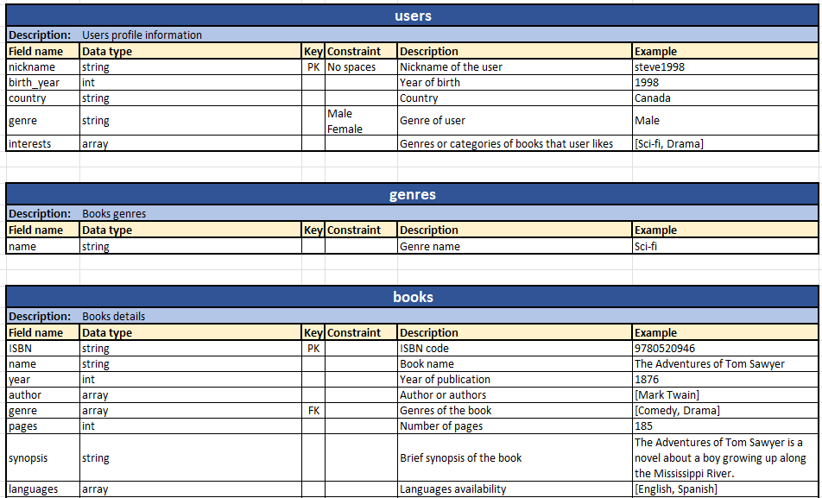
Database Dictionary
Knowing the data dictionary is crucial as it outlines the structure and attributes of collections, ensuring accurate data manipulation, efficient indexing, informed application development, and effective query optimization, which collectively lead to a well-performing and organized database system.

Slide 4
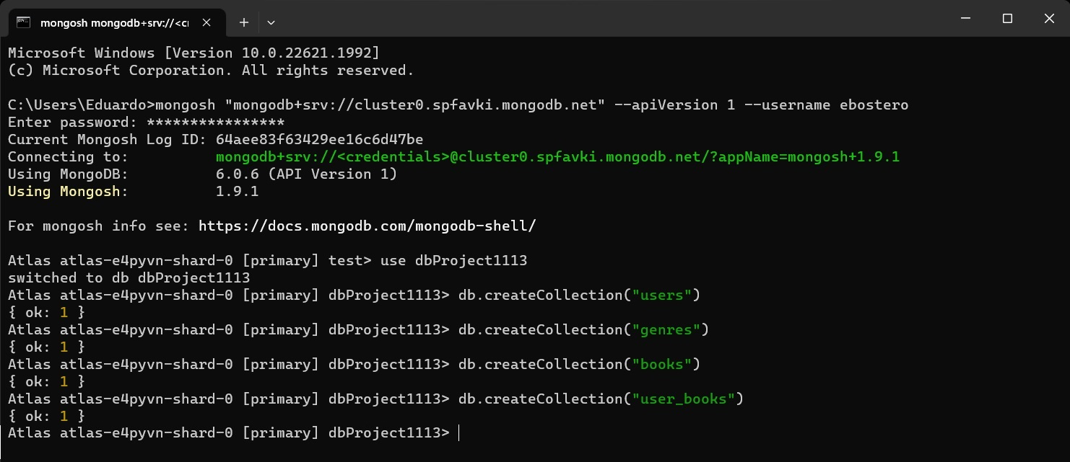

Mongo Database

Slide 5
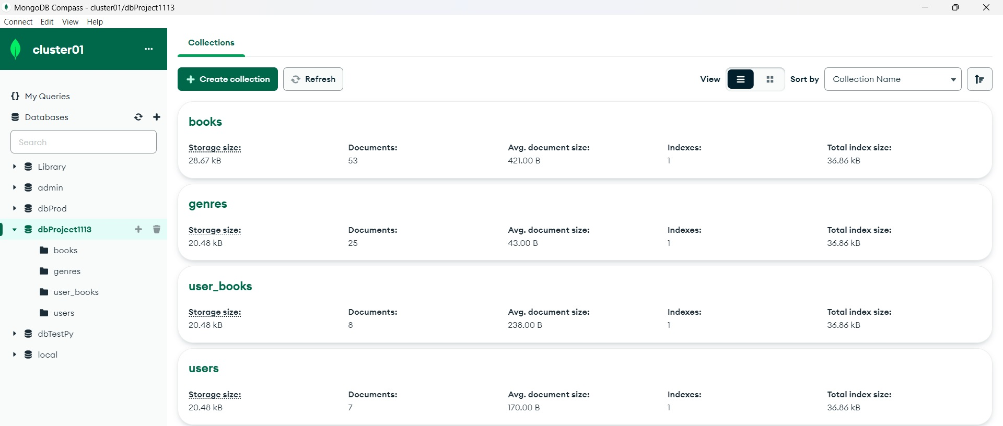
Mongo Database

Slide 6
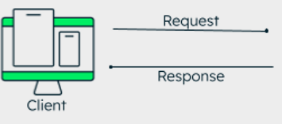

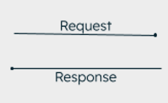


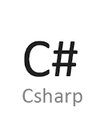
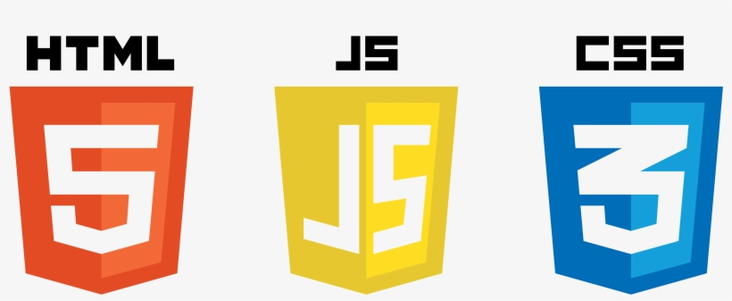
Application Architecture
Azure Cloud
Atlas
JSON
MongoDb.Driver
API REST

Slide 7
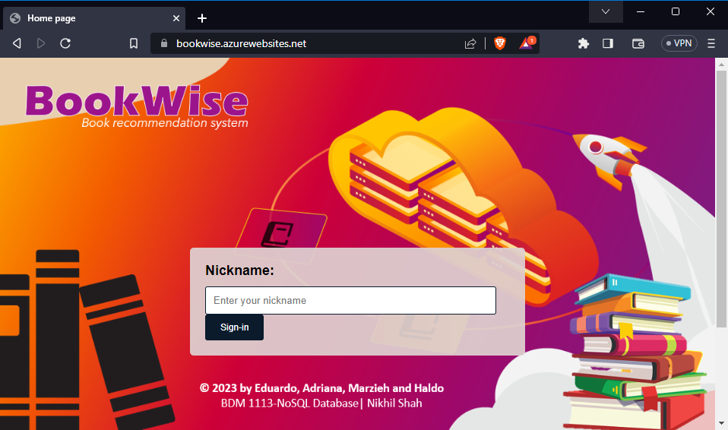
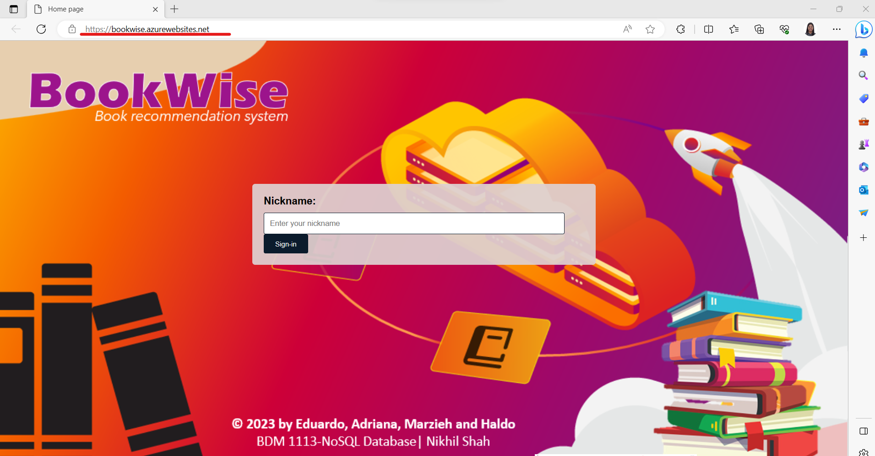
DEMO: BookWise

Slide 8
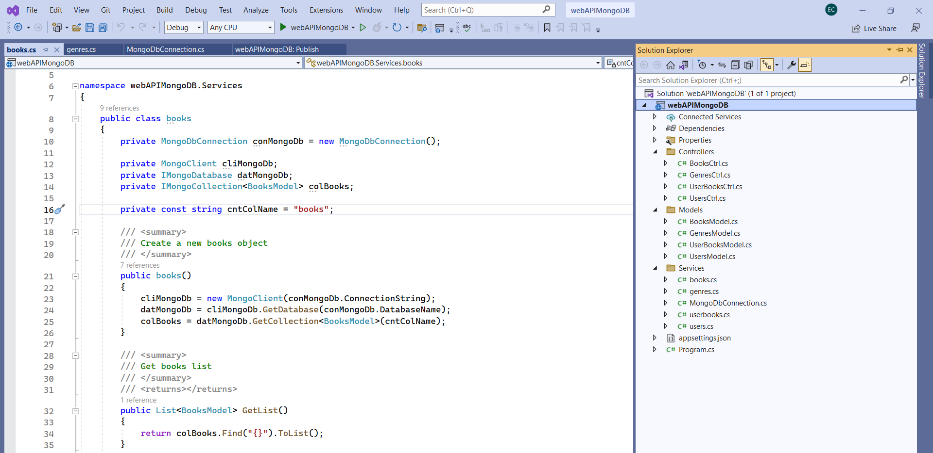
Let’s review the code!

Slide 9
Questions?

Slide 10
Thanks!

